Slide 1
The challenge of measurement in education: the case of out of school children data
Charles Gale
Research Associate
Education Policy and Data Center, FHI 360
cgale@fhi360.org

Slide 2
57,247,729

Slide 3
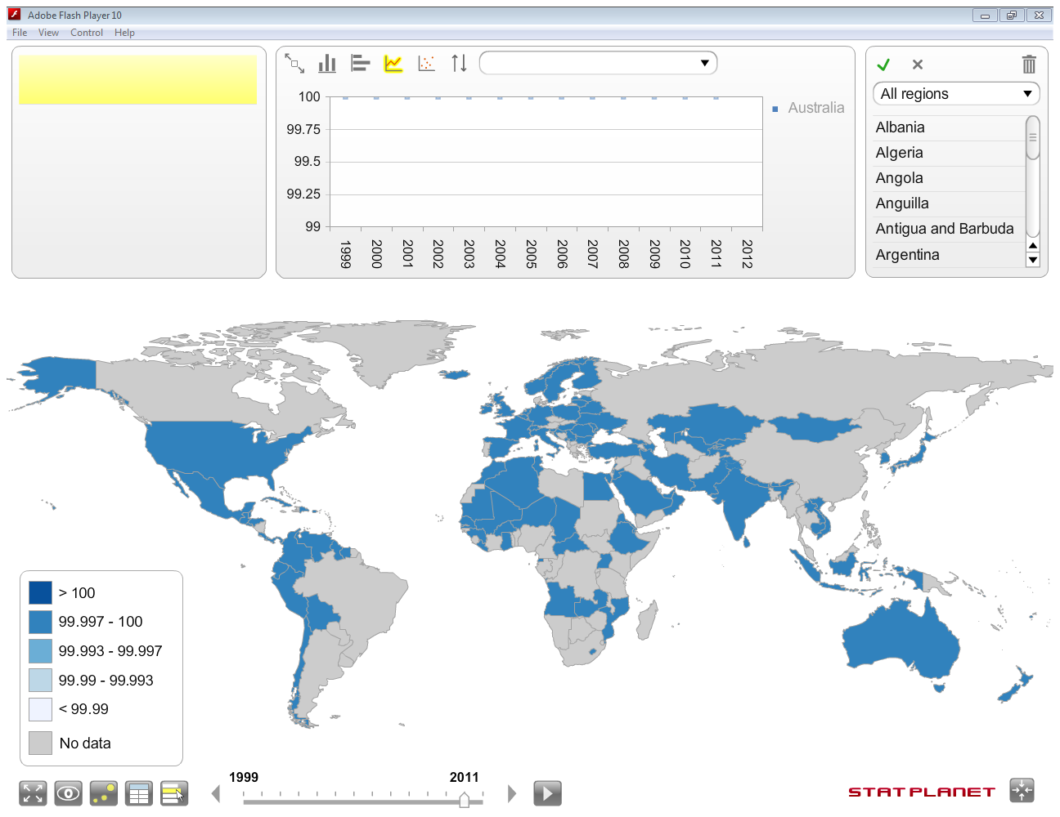
Number of out of school children, primary ages, 2011 (UIS Data Centre, accessed February 2, 2014)
2011 figure available
No 2011 figure available
Map created using Stat Planet (http://www.statsilk.com/)
Notes:
Countries in blue have data available for 2011. Countries in grey have values which are imputed based on data for other years, or by other methods which will be discussed in the second presentation.
In any given year, roughly 40% of data are unpublished.

Slide 4
Overview - data gaps and EFA goal 2
Source: 2013 GMR
Notes:
By region, published estimates may represent as little as 38% of the total… the largest data gaps are in Sub Saharan Africa, where data are missing for 14 countries.
The false sense of precision we get from a number like 57,247,729 obscures the fact that many of these quality, discrepancy and missing data issues have yet to be rectified. These issues should be central to any post-2015 ‘data revolution’.

Slide 5
Overview
How many primary-aged children are out of school?
How many
Data source
Administrative
Household survey
primary-aged children
Variation in ‘primary’
Across countries
Within countries
Over time
are out of school?
School coverage
Private providers
Pre-primary

Slide 6
How many primary-aged children are out of school?
Data source
Administrative
Household survey

Slide 7
Out of school rate, primary, administrative vs. household survey sources
Notes:
The graphic shows differences between primary out of school rates based on UIS estimates and those that EPDC calculated based on household survey sources.
In 10 countries the difference is 5 percentage points or greater.
Particularly consequential in large population countries such as India and Ethiopia.

Slide 8
Effect of India discrepancy between survey and administrative sources on global total of OOSC, primary
Source for global totals UIS Data Centre (accessed 2/16/2014)
Source for difference: EPDC (2013)
Notes:
“In India, for example, the 12 point discrepancy between 2006 Demographic and Household Survey (DHS) and same year figures in the UIS database amounts to an additional 14.6 million children out of school. In Ethiopia, the 21 point discrepancy between the 2011 DHS and same year UIS figures means that estimates of out of school children fluctuate by 2.9 million children, depending on the source used”
“The most recent publishable UIS estimate for the United Republic of Tanzania put the out-of-school population at 137,000 in 2008. According to the 2010 Demographic and Health Survey, however, the primary net attendance rate was 80%, well below the 98% net enrolment ratio estimate provided by the UIS for 2008” (p. 54)

Slide 9
Global Initiative on Out of School Children
“It should be noted that there is no one correct figure on out-of-school children. The numbers of OOSC from household survey data analysis and administrative data indicate the range of numbers of OOSC in a country” (UIS-UNICEF, 2014)

Slide 10
How many primary-aged children are out of school?
Variation in ‘primary’
Across countries
Within countries
Over time
Notes:
Administrative data supplied by country governments to UIS in yearly questionnaire, and the two primary household surveys we focus on (DHS and MICS) are typically done every five years in most low and lower middle income countries
Key here is to note the difference between enrollment (administrative sources) and attendance (household survey sources)

Slide 11
ISCED 1 compared to national primary durations
Notes:
ISCED is the method of classification that UIS uses to standardize country schooling systems throughout the world. As can be seen it can be distinct from a country’s own defined schooling level durations, for example in India where primary is shortened from 8 to 5 years.
“The impact of these definitional differences on numbers of out of school children for countries is most dramatic in populous countries such as India and Ethiopia, which had populations of 1.2 billion and 83 million respectively in 2010, according to the United Nations Population Division (UNPD, 2011). In these countries, the expansion of age brackets may add millions to national estimates of the number out of school children” (p. 25).

Slide 12
Primary duration and entry ages, India, state compared to national
State or U/T | Primary Entry age | Primary Duration | Primary Age Range | % OOS local ages | % OOS ages 6-10
Goa | 5 | 4 | 5-8 | 15% | 4%
Kerala | 5 | 4 | 5-8 | 7% | 1%
Maharashtra | 5 | 4 | 5-8 | 18% | 9%
West Bengal | 5 | 4 | 5-8 | 26% | 16%
Orissa | 5 | 5 | 5-9 | 15% | 14%
Punjab | 5 | 5 | 5-9 | 20% | 12%
Sikkim | 5 | 5 | 5-9 | 33% | 20%
Uttar Pradesh | 5 | 5 | 5-9 | 28% | 20%
Source: International Bureau of Education (IBE), EPDC extraction of DHS dataset
Notes:
In addition to differences in primary durations across countries, there may be within-country differences as well. The table shows states of India which have stated primary durations that are distinct from the national 6-10 age range (not including upper primary).
National primary duration is considered 6-10. Using state-defined primary age ranges (according to IBE) the OOSC rate is 22% based on household survey data...reports published by Ministry of Human Resources Development avoid using “primary” or “upper primary” altogether and instead publish data for age ranges such as 6-10 and 11-13.

Slide 13
Number of out of school children, primary age, Burkina Faso
(2010)
Notes:
“Measurement is also complicated by changes in the entry age for primary school, as occurred in Burkina Faso in 2010. Estimates of out of school students of primary age rose from 983,031 in 2009 to 1,128,293 in 2010, disrupting the pattern of consistent decreases in out of school figures since 2003. The fact that this increase coincided with the adjusted entry age may reflect difficulties with enrolling a younger age cohort.
In addition, this means that the same age groups are not being observed over time. Looking at change in educational systems since 1990, 11 of the 40 countries (28%) included in this review had considered changes either to the entry age or to the duration of primary, compromising the comparability of education data over time” (27)

Slide 14
How many primary-aged children are out of school?
School coverage
Private providers
Pre-primary

Slide 15
Enrollment in unregistered schools, Kenya
Source: APHRC (2008)
Notes:
All else equal, household surveys can expect to be neutral in distinction between formal and non-formal schooling because household heads may not be aware of this distinction. “Drawing from a 2005 survey of households in two urban slum neighborhoods and two urban non-slum neighborhoods of Nairobi, APHRC shows that among enrolled 5-19 year-olds, 39% of those in the slum neighborhoods and 19% in non-slum neighborhoods were enrolled in ‘private schools’…the majority of these private schools were not registered with the Ministry of Education but did follow recommended curriculum and register their students to sit for national examinations (Oketch et al, 2008a)

Slide 16
Pre-primary attendance by age, Kenya
Notes:
According to HHS, of 37% of 6 year olds “out of school” almost 2/3 were in pre-primary…If children attending preschool were to be counted as in-school rather than out-of-school, Kenya’s out of school rate would decline from 13% to 5.5% for 6-11 year-olds (DHS, 2009).

Slide 17
Recommendations

Slide 18
Recommendations
Improve timeliness of data or adjust for time trends
Note: UIS estimates were current at time of publication
Notes:
Where data are not current, household surveys may be used to “plug in the gaps”
“Notwithstanding the differences in the data collection and calculation methods between administrative and survey sources, it is plausible that access to education may have substantially improved in these two countries over the years since the UIS data were collected. As the violent conflict in DRC has gradually reduced with the signing of peace accords in 2003 and other efforts, we would expect to see an increase in the scope and reach of the education system, with increasing enrollments particularly at the primary level. In Bangladesh, a number of active non-formal education providers have made it possible for many poor rural children to attend school in their own communities, which would have an effect on overall participation numbers”

Slide 19
Recommendations
Streamline basic definitions
Household survey as alternative source for out of school children numbers
Measuring school exclusion for standard age cohort such as 7-14
Notes:
Do Nigeria and Pakistan truly have the greatest number of children out of school? Household surveys have advantage in measuring school participation ‘regardless’ of type (non-formal, unrecognized private schools, etc.) of school.
While a ‘standardized’ age group used to measure school exclusion would gloss over cross-country differences in schooling levels, it could serve as a less opaque reference group than ‘primary’ durations that may range from 5-8 years.

Slide 20
Recommendations
Build a broad understanding of data quality concerns
Notes:
The 2005 UIS-UNICEF report represented an in-depth and frank discussion of issues surrounding data quality, variability and other issues in the calculation of out of school children. While the Global Initiative was spawned from this, there has been a seeming “backing away” from attempting to rectify these concerns in the calculation of a global number.
A renewed commitment to discussion about the issues raised in that report among a diverse group of stakeholders should be an important part of any ‘data revolution’ that takes place in the post-2015 development agenda.

Slide 21
References
Education Policy and Data Center. (2013). Out of school children: Data challenges in measuring access to education. Washington DC: FHI 360.
Oketch, M., Mutisya, M., Ngware, M., Ezeh, A., & Epari, C. (2008b). Pupil school mobility in urban Kenya (APHRC Working Paper No. 38). Nairobi: African Population and Health Research Center.
UIS. (2010). Measuring educational participation: Analysis of data quality and methodology based on ten studies. Montreal: UIS.
UIS Data Centre. Accessed at uis.unesco.org on 2/5/2014.
UIS & UNICEF. (2005). Children out of school: Measuring exclusion from Primary education. Montreal: UIS.

Slide 22
References
UIS & UNICEF. (2014). Global Initiative on Out of School Children. South Asia Regional Study. Kathmandu: UNICEF.
UNESCO. (2012). Youth and skills: Putting education to work. Education for All Global Monitoring Report 2012. Paris: UNESCO.
UNESCO. (2013). Teaching and learning: Achieving quality for all. Education for All Global Monitoring Report 2013. Paris: UNESCO.

Slide 23
Thank you!
Contact: cgale@fhi360.org

